Slide 1
BDD and the Sleepy Developer
Dermot Canniffe
https://bit.ly/BDDSleepyDev

Slide 2

Notes:
Hello, everyone. I’m Dermot, and I’m a sleepy head. Clinically speaking.

Slide 3
Notes:
Hello, everyone. I’m Dermot, and I’m a sleepy head. Clinically speaking.

Slide 4
What Are Sleep Disorders?
…conditions that affect sleep quality, timing, or duration and impact a person’s ability to properly function while they are awake. - Sleep Foundation

Slide 5
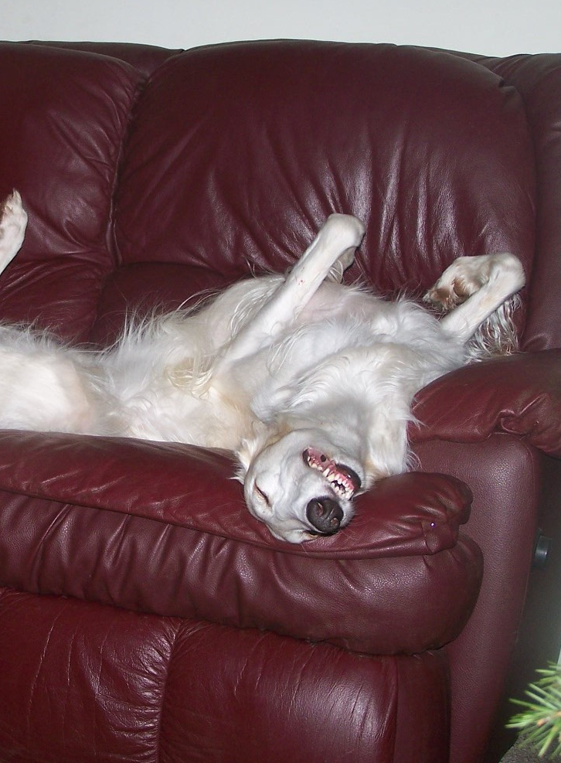


Zum Beispiel / Some Examples
Insomnia
Sleep Apnoea
Narcolepsy
Shift Work Disorder
Idiopathic Hypersomnia
Parasomnias
…
Deb West
Notes:
Some Sleep Disorders
https://www.flickr.com/photos/ferlinka/2137930667/ Deb West (CC BY 2.0)

Slide 6
Sleep Disturbance != Sleep Disorder
“Oh, I get that!”
- most people I talk to about sleep disorders
Notes:
Parasomnias != Sleep Disorder Idiopathic Hypersomnia - Idiopathic hypersomnia was first described in 1976 – and the name still holds! We still don’t know what exactly causes it. People’s experience is subjective and reporting is poor. We don’t even know that much about sleep: why do we sleep? Necessary biological “rinse cycle” or weird evolutionary quirk?

Slide 7
Sleep Disorders and Working Life
Sleep problems and work injuries: A systematic review and meta-analysis – K. Uehli et al
The findings of the meta-analysis suggested that workers with sleep problems had a 1.62 times higher risk of being injured than workers without sleep problems (RR: 1.62, 95% CI: 1.43–1.84). Approximately 13% of work injuries could be attributed to sleep problems.
Insomnia and its relationship to health-care utilization, work absenteeism, productivity and accidents – M. Daley et al
In terms of daytime function, 25.0% of the [Insomnia Syndrome Group] had been absent from work relative to 17.1% of [the Good Sleeper Group], 40.6% reported having experienced reduced productivity compared to 12.3% of [Good Sleepers]
Notes:
Sleep Disorders and Working life
Katrin Uehli, Amar J. Mehta, David Miedinger, Kerstin Hug, Christian Schindler, Edith Holsboer-Trachsler, Jörg D. Leuppi, Nino Künzli,
Sleep problems and work injuries: A systematic review and meta-analysis,
Sleep Medicine Reviews,
Volume 18, Issue 1,
2014,
Pages 61-73,
ISSN 1087-0792,
https://doi.org/10.1016/j.smrv.2013.01.004.
(https://www.sciencedirect.com/science/article/pii/S1087079213000087) Daley M, Morin CM, LeBlanc M, Grégoire JP, Savard J, Baillargeon L. Insomnia and its relationship to health-care utilization, work absenteeism, productivity and accidents. Sleep Med. 2009 Apr;10(4):427-38. doi: 10.1016/j.sleep.2008.04.005. Epub 2008 Aug 26. PMID: 18753000.

Slide 8
Sleep Disorders and Working Life
Sleep problems and work injuries: A systematic review and meta-analysis – K. Uehli et al
The findings of the meta-analysis suggested that workers with sleep problems had a 1.62 times higher risk of being injured than workers without sleep problems (RR: 1.62, 95% CI: 1.43–1.84). Approximately 13% of work injuries could be attributed to sleep problems.
Insomnia and its relationship to health-care utilization, work absenteeism, productivity and accidents – M. Daley et al
In terms of daytime function, 25.0% of the [Insomnia Syndrome Group] had been absent from work relative to 17.1% of [the Good Sleeper Group], 40.6% reported having experienced reduced productivity compared to 12.3% of [Good Sleepers]
Notes:
Sleep Disorders and Working life
Katrin Uehli, Amar J. Mehta, David Miedinger, Kerstin Hug, Christian Schindler, Edith Holsboer-Trachsler, Jörg D. Leuppi, Nino Künzli,
Sleep problems and work injuries: A systematic review and meta-analysis,
Sleep Medicine Reviews,
Volume 18, Issue 1,
2014,
Pages 61-73,
ISSN 1087-0792,
https://doi.org/10.1016/j.smrv.2013.01.004.
(https://www.sciencedirect.com/science/article/pii/S1087079213000087) Daley M, Morin CM, LeBlanc M, Grégoire JP, Savard J, Baillargeon L. Insomnia and its relationship to health-care utilization, work absenteeism, productivity and accidents. Sleep Med. 2009 Apr;10(4):427-38. doi: 10.1016/j.sleep.2008.04.005. Epub 2008 Aug 26. PMID: 18753000.

Slide 9

Stalin is too crude, and this defect which is entirely acceptable in our milieu and in relationships among us as communists, becomes unacceptable in the position of General Secretary. I therefore propose to comrades that they should devise a means of removing him from this job and should appoint to this job someone else who is distinguished from comrade Stalin in all other respects only by the single superior aspect that he should be more tolerant, more polite and more attentive towards comrades, less capricious, etc.
—Lenin, 4 January 1923

Slide 10
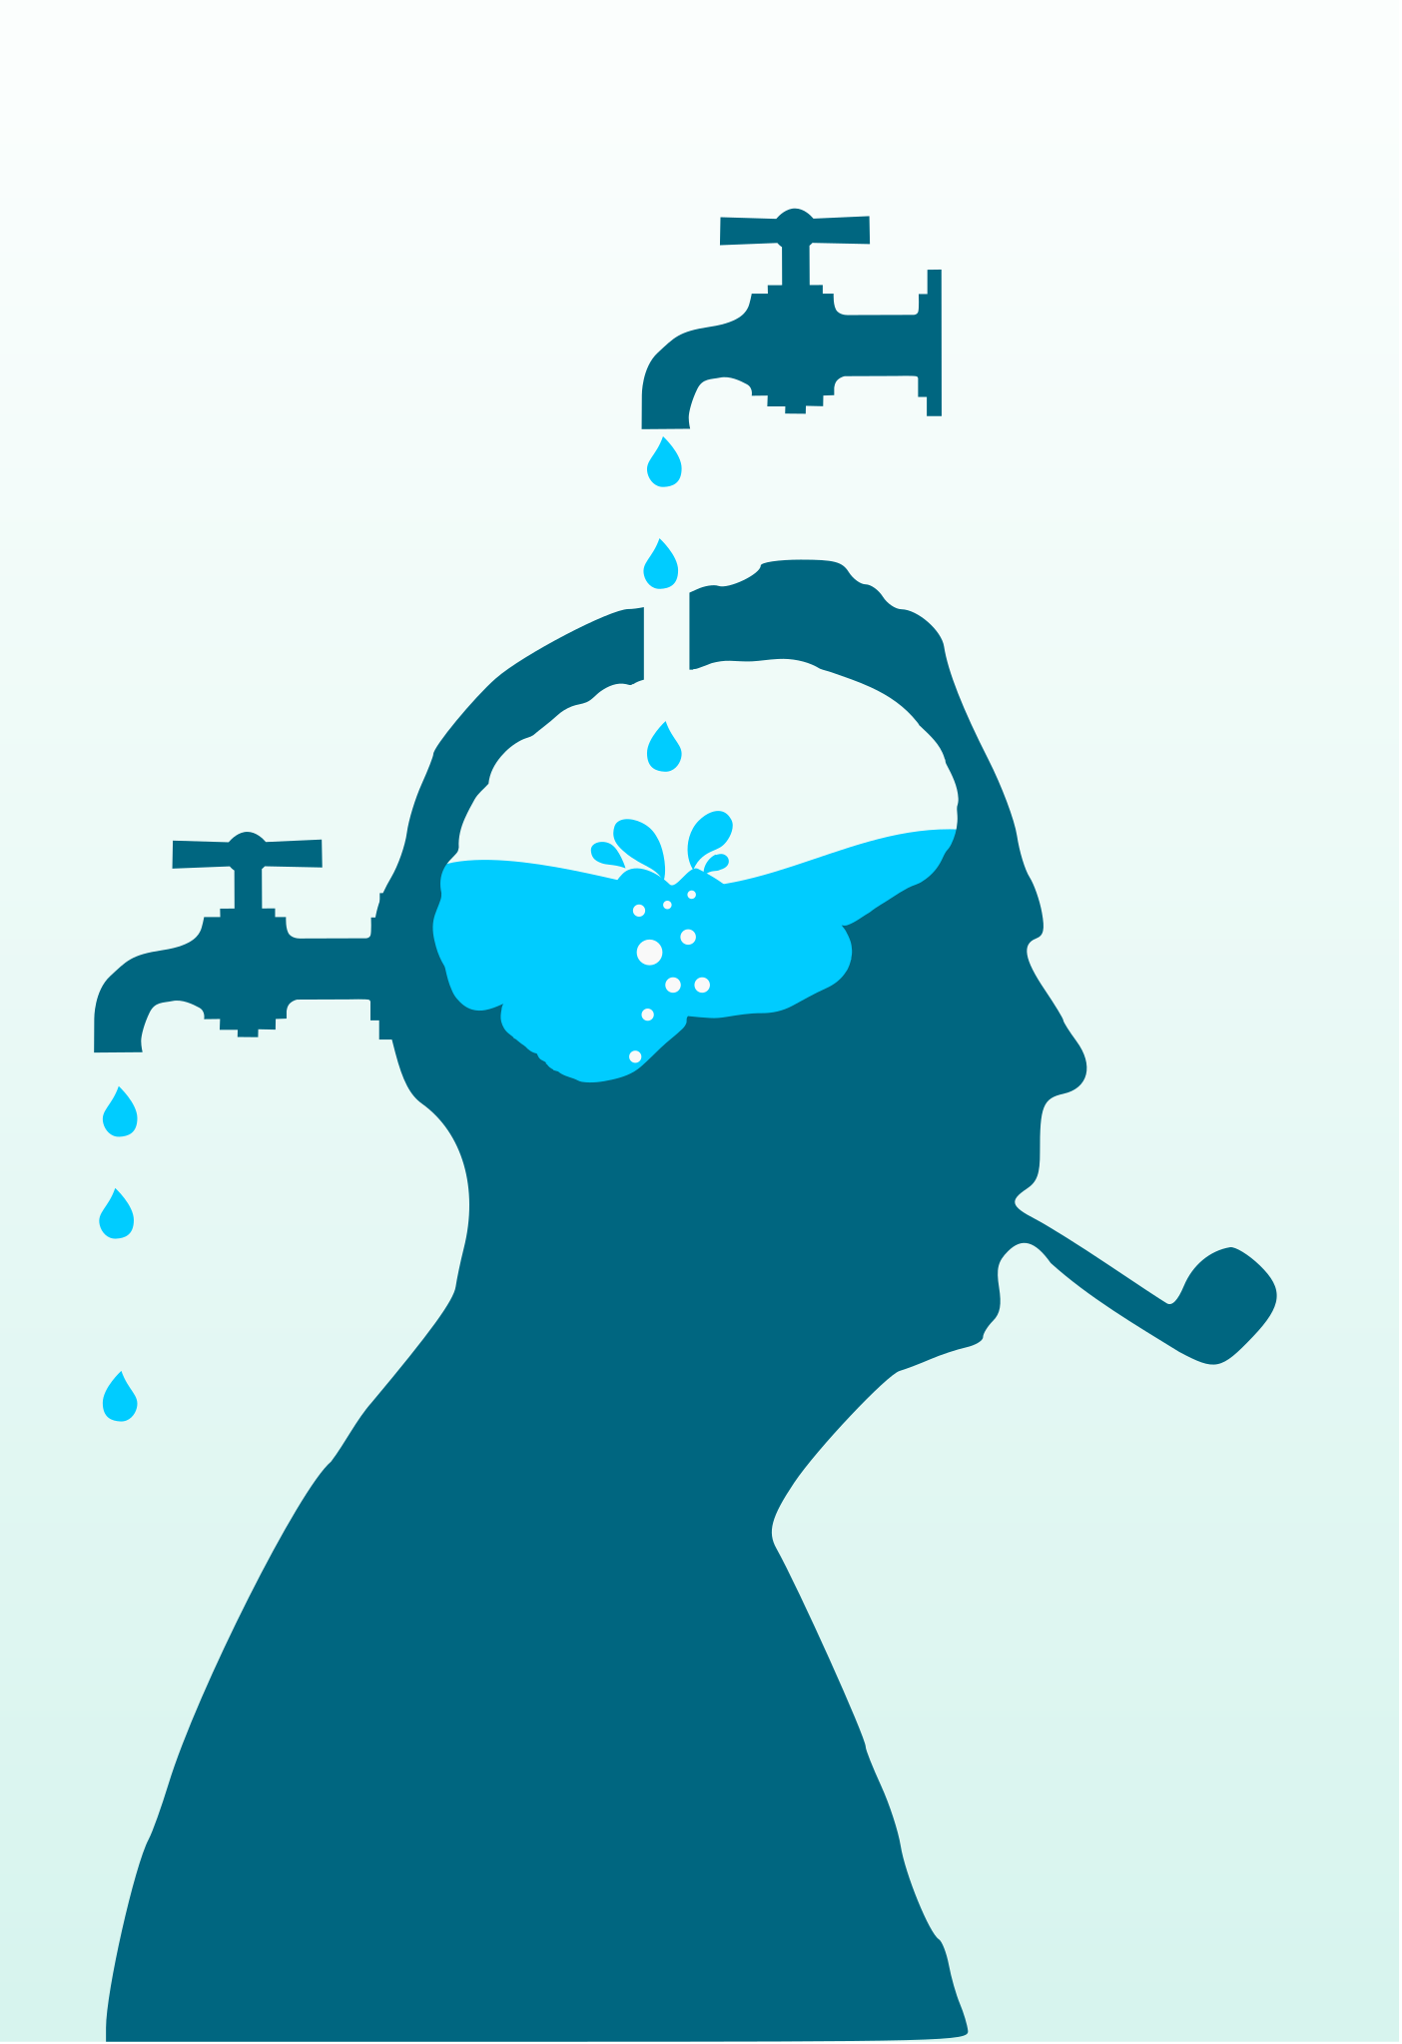
Memory Issues
Short Term Memory Deficit
Memory Deficit out of context
A need for more time or repetition
Difficulty following multi-step directions
Nevit Dilmen
Notes:
Memory Issues are also common among those who suffer from Sleep Disorders. That can include short term memory deficit, within minutes or hours of absorbing info, it’s gone. Most of us have experienced the “Context Switch Penalty” whereby if we are interrupted from a task in which we were cognitively invested, returning that task takes time. This is made more complicated if we cannot remember aspects of that task . Reiteration and processing time can also be necessary, and in certain circumstances may be perceived as being problematic.
And also, for testers in particular, a difficulty in following multi-step directions – for example – test plans – can make life very difficult indeed. Statistics: Memory problems are reported by 79% of IH patients and attention problems by 55%. A feeling of one’s mind going blank (58%) or making a mistake in a habitual activity (61%) are also reported commonly by IH patients, more so than by controls for all of these symptoms (17). Checklist for Working Memory Symptoms
A need to re-read text.
Difficulty following multi-step directions.
Difficulty staying engaged in class.
Test anxiety, especially on multiple choice tests.
A need for more time and repetition.
Inconsistent performance.
Lack of focus and attention deficit disorders.
CC BY-SA 3.0
© Nevit Dilmen

Slide 11


Other Cognitive Issues
“Brian Fog”
“Brain Forg”
“Brain Fog”
Hallucinations
Marco Verch
Notes:
Sleep Disorders and Working life
Aside from the actual sleep disturbances and sleepiness happening during inconvenient times
Some of the main ones are ; Sleep Drunkenness Decreased Energy Restlessness Irritability “Brain Fog” Inability to focus Memory problems Hallucinations
Marco Verch - the CC-BY license https://creativecommons.org/licenses/by/2.0/

Slide 12
Memory Issues
Short Term Memory Deficit
Memory Deficit out of context
A need for more time or repetition
Difficulty following multi-step directions
Nevit Dilmen
Notes:
Memory Issues are also common among those who suffer from Sleep Disorders. That can include short term memory deficit, within minutes or hours of absorbing info, it’s gone. Most of us have experienced the “Context Switch Penalty” whereby if we are interrupted from a task in which we were cognitively invested, returning that task takes time. This is made more complicated if we cannot remember aspects of that task . Reiteration and processing time can also be necessary, and in certain circumstances may be perceived as being problematic.
And also, for testers in particular, a difficulty in following multi-step directions – for example – test plans – can make life very difficult indeed. Statistics: Memory problems are reported by 79% of IH patients and attention problems by 55%. A feeling of one’s mind going blank (58%) or making a mistake in a habitual activity (61%) are also reported commonly by IH patients, more so than by controls for all of these symptoms (17). Checklist for Working Memory Symptoms
A need to re-read text.
Difficulty following multi-step directions.
Difficulty staying engaged in class.
Test anxiety, especially on multiple choice tests.
A need for more time and repetition.
Inconsistent performance.
Lack of focus and attention deficit disorders.
CC BY-SA 3.0
© Nevit Dilmen

Slide 13
Behaviour Driven Development - Practices
Key Practices:
Discovery
Formulation
Automation
Minor Practices
Mobbing/Pairing
Centralising Knowledge
Democratised Planning
Flexibility
Notes:
Behaviour Driven Development Practices
Behaviour Driven Development was devised to address drawbacks that had become apparent in more traditional methods of developing software. The main issue being communication – how do we ensure that everyone in our organisation are working from the same page – having the same understanding of what we need to develop, and how. So when discussing BDD we often talk about “The three Practices” BDD ideally consists of three Practices – the first is Discovery – our stakeholders get together to reach a shared understanding of the requirements through a structured conversation centering on rules and examples. One way of capturing this information is with Example Mapping. The next practice is Formulation, where one or more stakeholders write Scenarios that describe what behaviour we desire from the software. The third practice is Automation, where we take these scenarios and automate them using an automation framework – for example Cucumber, SpecFlow, Behave, to make that scenario happen. Then we run it, and it fails. We use this failing Test to drive our development, writing just enough code to make the test pass, and then we Refactor – refine the new code so that it is more robust and aligns better with best practices and so on.
As well as these key practices, I would contend that there are other practices that teams following BDD based workflows have a tendency to adopt. Mobbing or Pairing, where teams collaborate on creating a solution, whether it’s coding, or writing presentations, proposals or whatever is necessary.
They have a tendency to expand the “Single Source of Truth” philosophy to everything – i.e. there is one place which is optimal for recording Q&A (e.g. Slack), or keeping slideware, or other non-software documentation in a single place, maybe even the same place as the code and features. Democratised planning is based on principles from the Agile Manifesto, but teams that follow BDD based workflows take it to heart Flexibility- that could be around working time, adapting to unexpected circumstances…

Slide 14

Behaviour Driven Development - Culture
Each Voice is equally important
Each Person is equally important
The Team succeeds when everyone succeeds
“Failure” is a learning experience
“Failure” outcomes can be managed
We meet each contributor where they are
Collaboration & Communication is key
Notes:
Behaviour Driven Development Culture
Some of these are emergent, most of them were very much the intent of people who devised and refined Behaviour Driven Development
The approach very much emphasises the importance that the humans involved have. To quote Katherine Kirk “Be Human. Be Fluid. Innovate with this.” The practice of Discovery illustrates this – each of the people in attendance has a viewpoint which is valid and recognised.
Team ownership extends that Agile democratic approach to the teams themselves – the team doesn’t just own it’s own quality and deliverables, it owns itself and looks after itself!. As As a collective, we want each member to be at their best, and be fulfilled, and even enjoy the work! Because we know that the team fares better when the team members are doing well.
I can’t emphasise enough the positive impact that a Safe-To-Fail environment can have on engineers, particularly those who are coming with new eyes/minds , whether they’re new to the industry or new to the organisation, or new to this manner of developing software. Mistakes happen. It’s sensible to understand that however much we try, even the most experienced of us will screw up. It’s not going to result in a major catastrophe unless we allow it. Manage inevitable failure rather than trying to make everyone perfect, because it’s impossible. If Juniors see this in practice, they see seasoned engineers exhibiting good grace around “failure”, then they might not end up as messed up by the time they reach professional seniority. They’ll feel more empowered to ask “bad questions”, to be creative, knowing that the worst that can happen is we figure out it’s a dead end and we pivot to something else. And everything is a collaboration. We understand that the humans we work with have history, emotions, good days, bad days. I’d argue that Good Collaboration includes empathy.
CC BY 2.0 : https://thoroughlyreviewed.com

Slide 15
Example Mapping
Story:
We want those with Sleep Disorders to be empowered to contribute equally
Rule:
We can’t let temporary cognitive deficit get in the way of a good Story
Rule:
Sleepiness Will Happen, we need to allow for this
Rule:
We need some “Bad Day” contingencies
Rule:
We need to allow for memory issues too
Example: Example Mapping helps Dermot understand concepts and requirements quickly and easily
Example: It doesn’t matter so much when Dermot does the work, just that it gets done
Example: adapting to circumstance, means Dermot can “Fail” a day without bad consequence
Example: Single Source of Truth means that Dermot has a canonical “memory backup” to check
Example: Plain language Scenarios helps Dermot understand requirements quickly and easily
Question: Who else on the Team might benefit from these approaches?
Example: Collaborative Meetings help Dermot understand everything quickly and easily
Notes:
So let’s map this! Example mapping is a way of gathering ideas, and is one way to conduct a good discovery session. We start with our story at the top, define some rules by which we intend to implement the change, and for each rule we come up with concrete real world examples that illustrate how the rule will be experienced in practice.

Slide 16
Qui Bono?
Question: Who else on the Team might benefit from these approaches?
Other Sleepy Heads
People with chronic illness
People with mental health issues
…
Everyone!
Notes:
By explicitly addressing this experience of working, we raise awareness and acceptance, not just of sleep disorders and those who have them, but other chronic conditions as well. And everyone experiences transient disturbances that are part of daily life for those with a sleep disorder. Everyone has a bad night’s sleep, for example, or a bout of insomnia. It doesn’t have to be chronic for it to impact our day. So, everyone can benefit from mechanisms that empower the person and their insight, creativity and contribution. I’ve used BDD here as an example, based heavily on my own experiences, but it could work for every approach, if we just take the time to listen, and understand.

